Slide 1
Writing for your research community, writing for thr European Educational Research Journal (EERJ)
Wednesday, 3 September 2021
Paolo Landri
Drawing on a presentation by Eric Mangez, Université de Louvain, Belgium
Maarten Simons, University of Leuven, Belgium
(ppt with support of Jan Elen, Joke Torbyns)

Slide 2
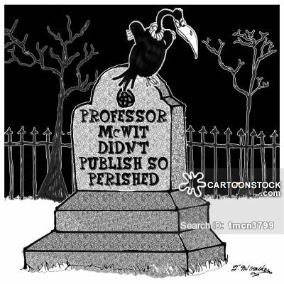
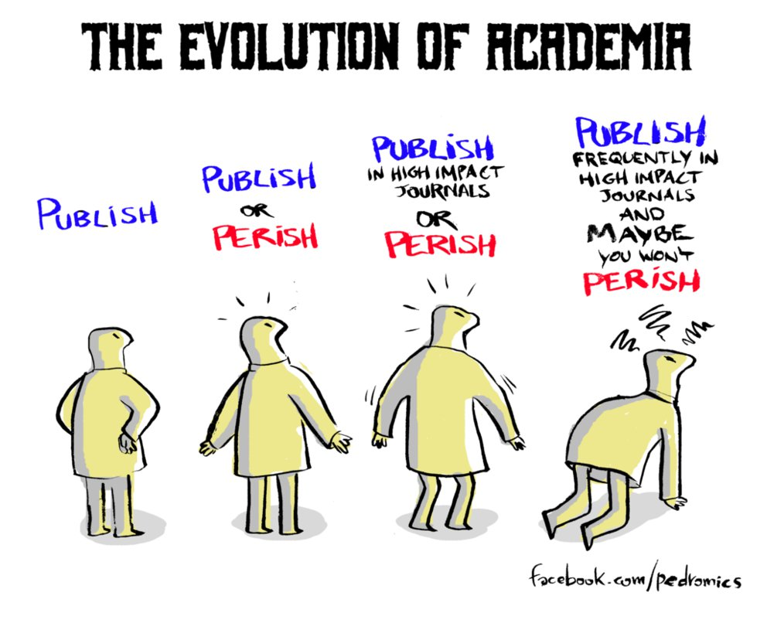
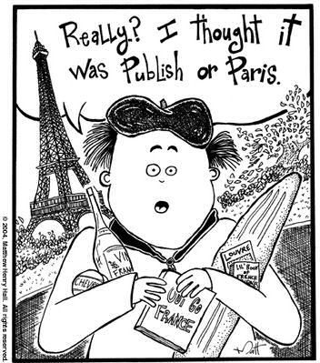
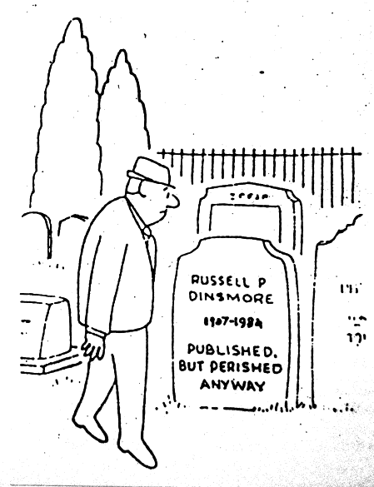

Slide 3
Academic work implies writing and publishing
Tension: your academic interests & external (but often pressing) requirements
Why publishing? Why making something public?
Considerations:
what is your aim? (discussion with peers, informing field of practice, intervening in social debates, informing policy makers …)
who is your audience? (general-specific, national/regional-international, …)
what kind of research? (project related/case study reporing, long term research and theoretically/conceptually oriented, …)
Several possibilities: reports, blogs, opinion papers, ‘professional’ journals, academic books, (inter)national academic journals, …
How to write: see https://patthomson.net

Slide 5
Conceiving article
Selecting journal
Preparing article for journal / submitting
Handle reviews
Publishing (open access)

Slide 6
Conceiving article
Different types of research articles
Empirical study
Literature review
Theoretical article
Methodological article
Case study
Other types of articles, including book reviews, brief reports, comments to articles, …

Slide 7
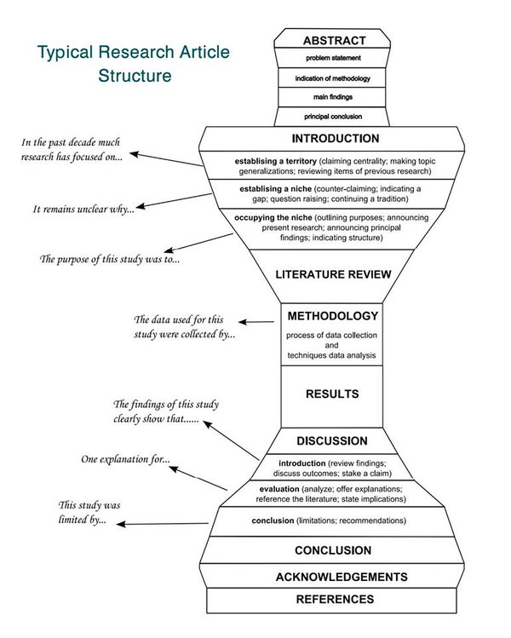
Conceiving article

Slide 8
An example…

Slide 9
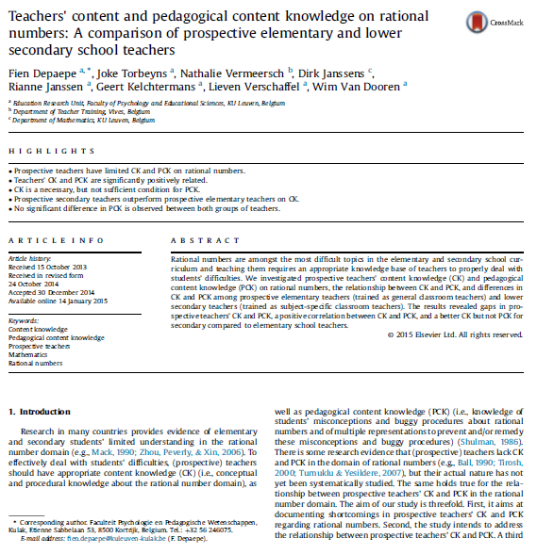

Slide 10
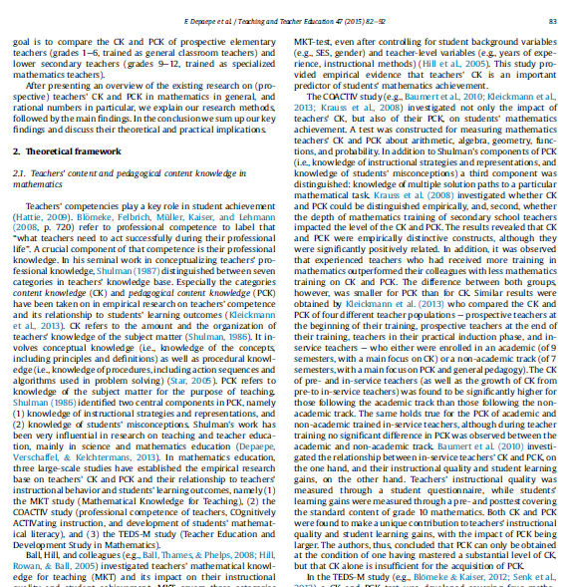

Slide 11
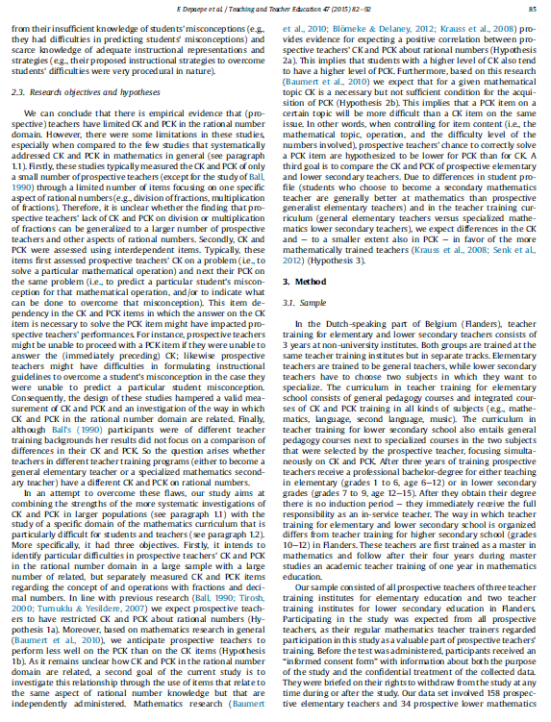
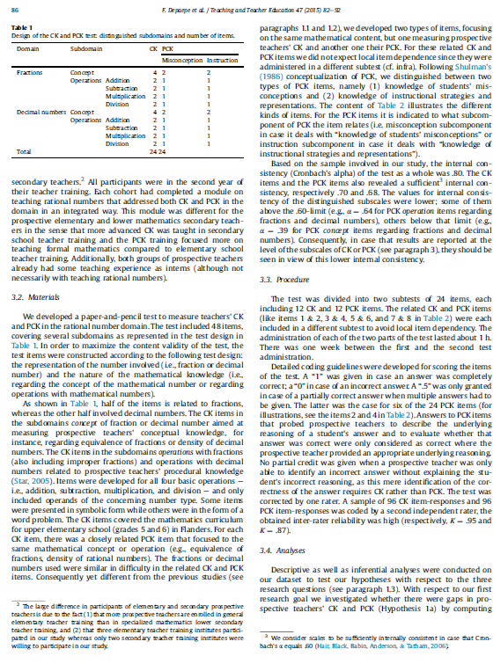

Slide 12
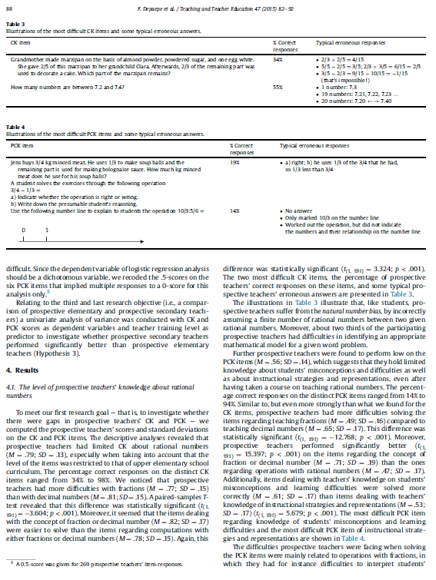
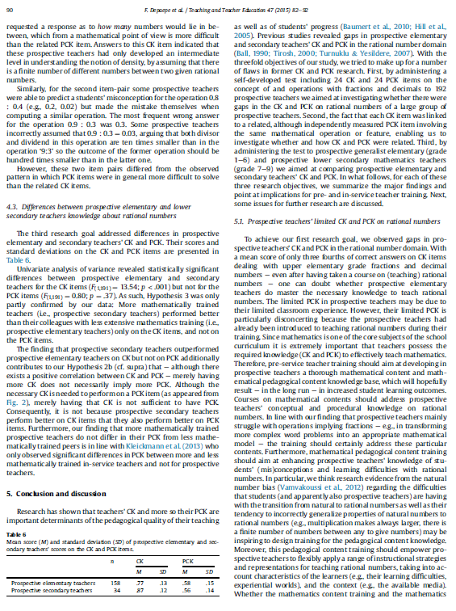

Slide 13
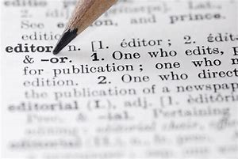
Some suggestions from editors…

Slide 14
Abstracts
"A good abstract will tell you what the key issue that's addressed is, it'll give you an idea of the methods that have been used and the conclusions that have been arrived at. So that abstract ought to tell someone whether it's worth them spending part of their life reading this paper. If the abstract doesn't do that the chances are the paper will have further weaknesses".

Slide 15
Abstracts
Your abstract is what readers will use when they are deciding whether to read your article. For this reason your abstract is very important and you should spend time making sure that it is readable and that it contains a complete description of your research.
In approximately 100-200 words, you will need to summarize your findings and what the implications of those findings are.
The abstract must be accurate as a reflection of what is in your article.
The abstract must be self-contained, without abbreviations, footnotes, or incomplete references. It must make sense on its own.
It is a good idea to include keywords in your abstract, as this will help readers to find it. Key phrases need to make sense within the abstract.
Check that the abstract reads well.

Slide 16
Title
"We would typically expect a strong title, a good title that really expressed what the article was about and made it clear to the reader exactly what the topic was, and it's amazing how often writers neglect to do that. Unless the title says, very simply and clearly, what the article is about, it's quite difficult for the reader and certainly for the referee and the Editor to immediately judge what the item is focusing on.”
Your article title should be concise, accurate, and informative. Titles are often used by search engines and other information retrieval systems. The title should be specific and it should contain words that readers might be searching for.
This will make it more likely that people will find and read your article. The title must reflect the content of your article; if it does not, readers will be confused or disappointed. The title must also be comprehensible to the general reader outside your field.

Slide 17
Keywords
It is essential that authors, editors, and publishers make every effort to ensure articles are found online, quickly and accurately, ideally within the top three hits. The key to this is the appropriate use of keywords.
Recent evidence suggests that a strong correlation exists between online hits and subsequent citations for journal articles. Search engines rank highly as starting points. Students are increasingly more likely to start their research by using Google ScholarTM, rather than by the traditional starting point of Abstracting and Indexing resources.
We know that the use of keywords helps to increase the chances of the article being located, and therefore cited.

Slide 18
Methodology
"If your paper covers any empirical research that you've done, whether it's a survey, interviews, participant observations, even if it's desk-based research when you've analysed previous work, you have to tell the reader something about your methods. It doesn't mean that the whole paper has to be devoted to that but you have to give the reader a sense of whether they can trust you. How did you decide your sample, what were the key questions you were looking at?"
"In terms of a good article we're interested in the new, we're interested in people doing things differently... we're interested in papers that attempt to be innovative, equally so in relation to research processes, research methods, research that attempts to do things differently."

Slide 19
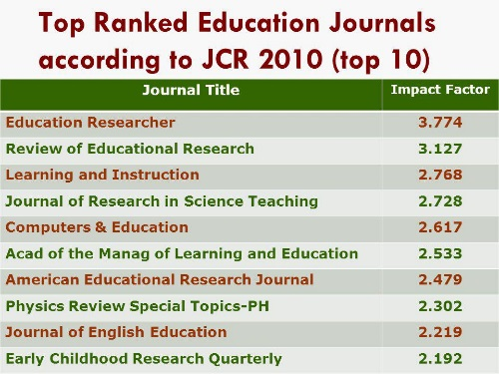
Selecting journal
Aims and scope

Slide 20
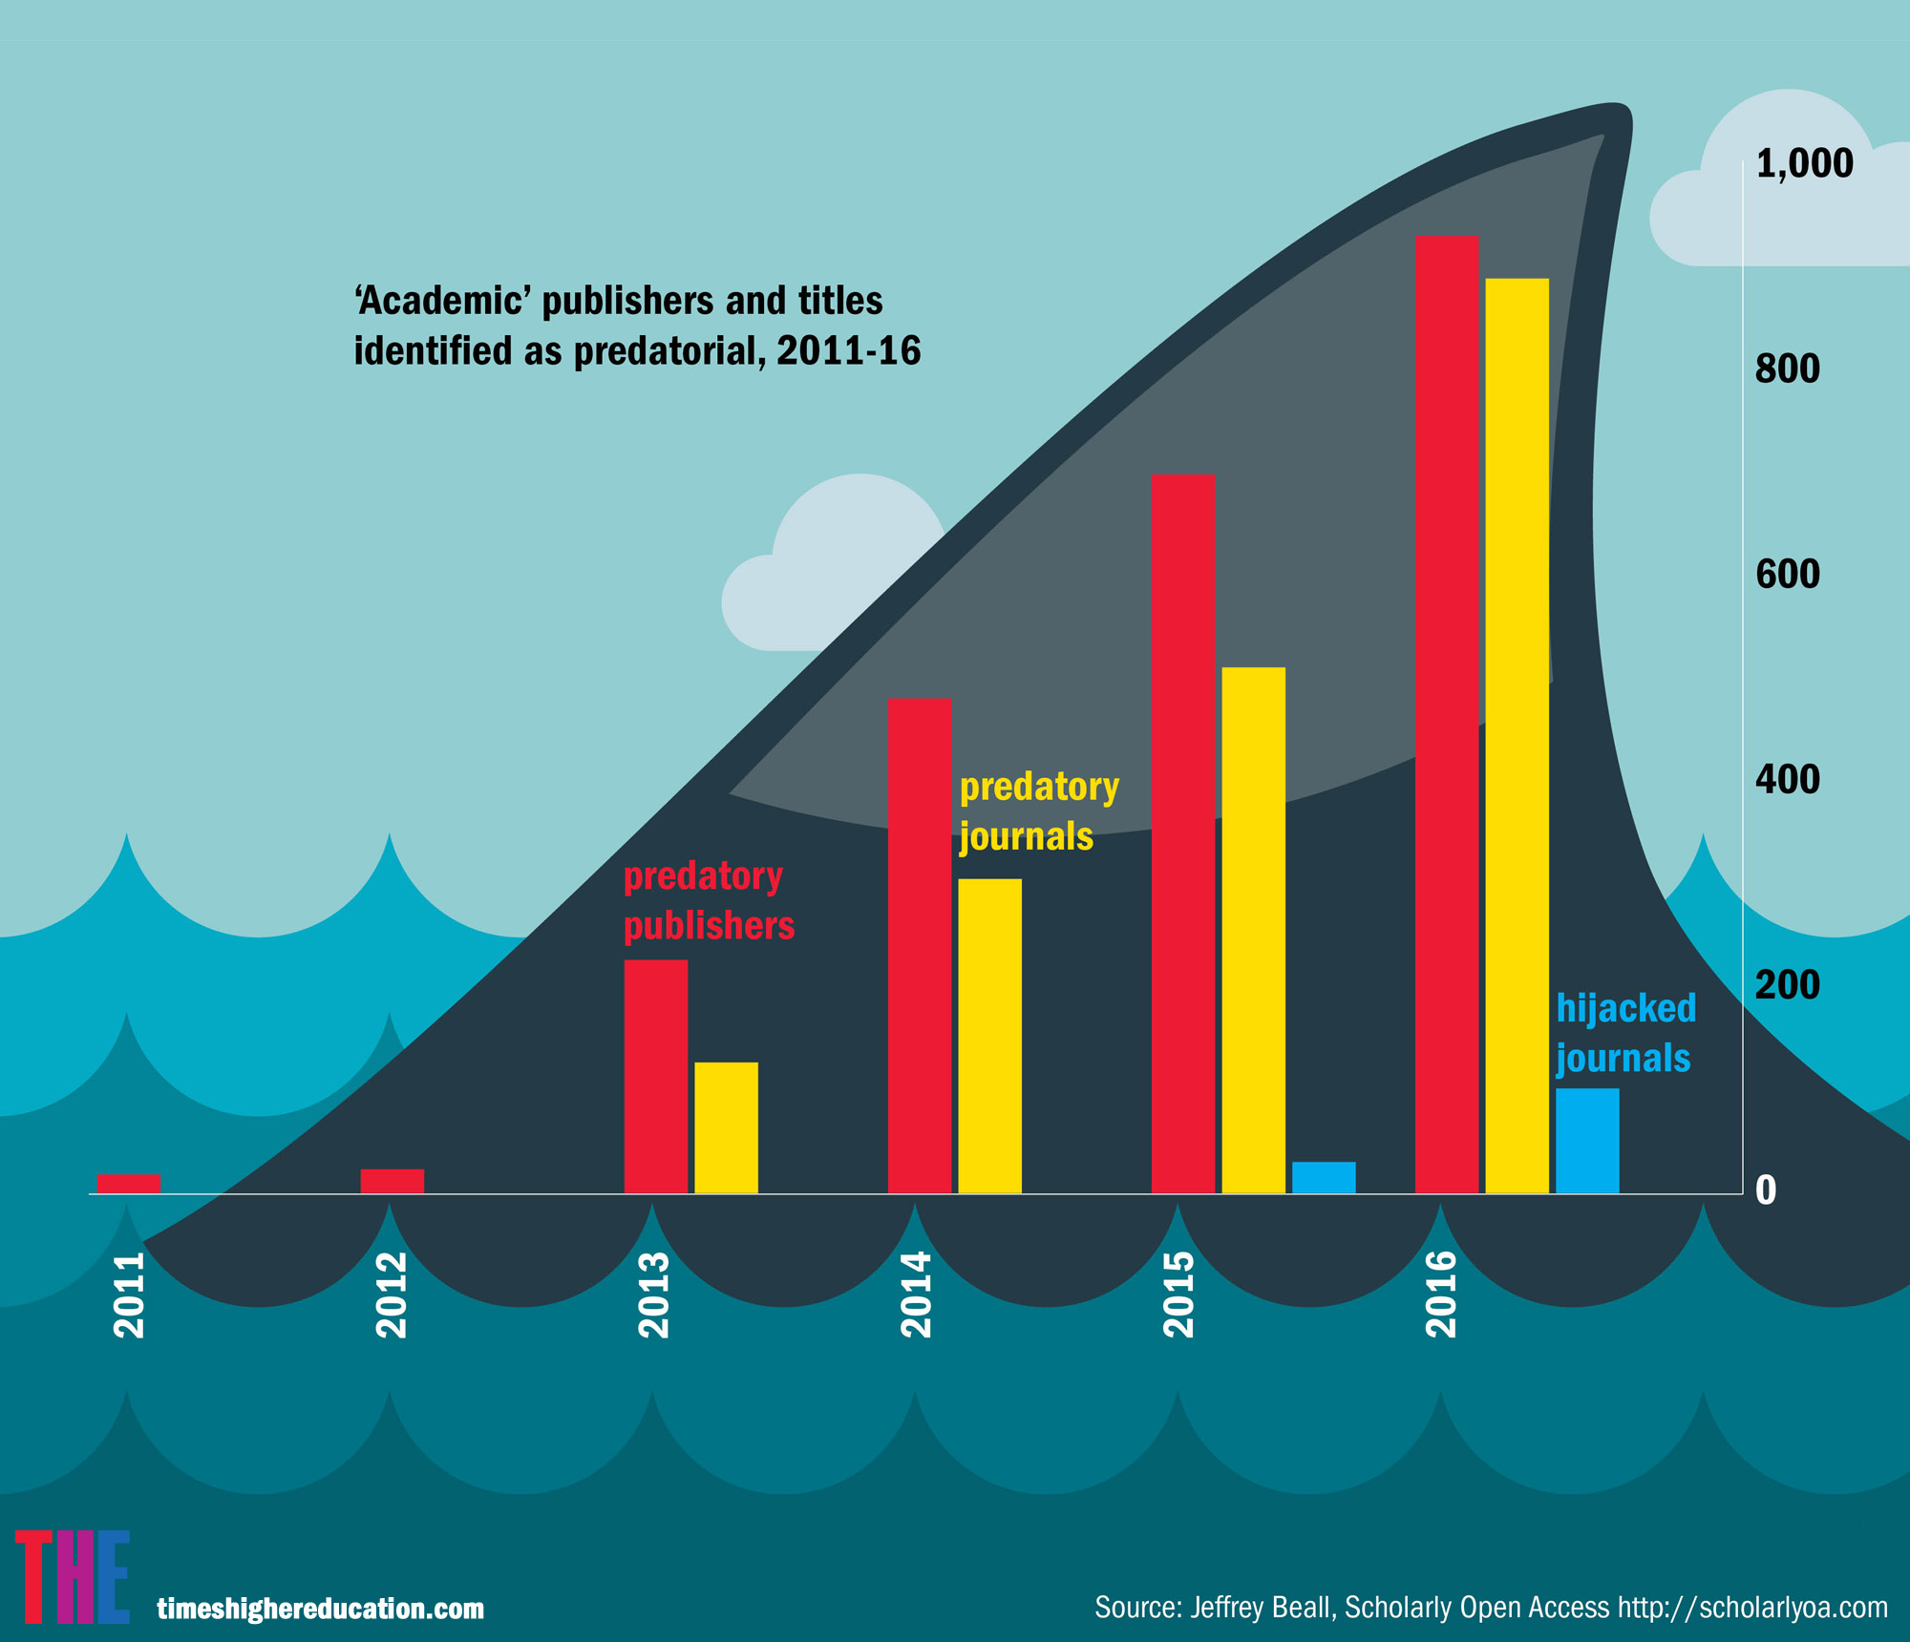
https://beallslist.weebly.com/

Slide 21
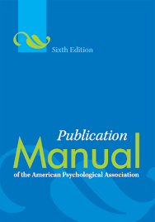
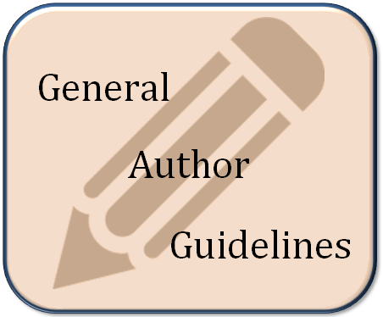
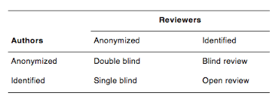
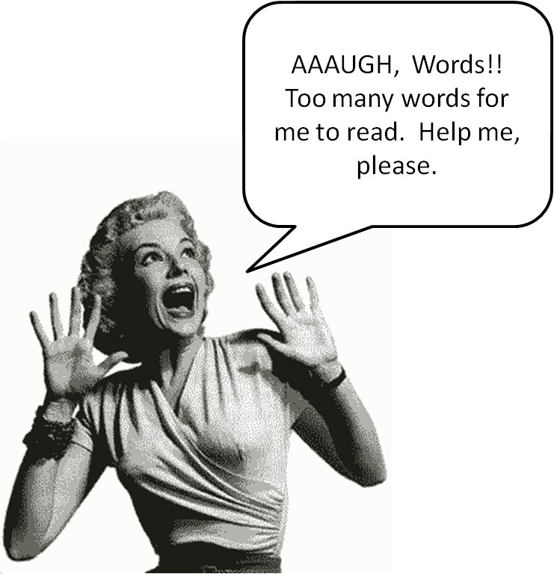
Preparing article for journal / submitting
Check editorial policies
Peer review policy
Authorship
Ethics (e.g. informed consent)
Number of pages/words
Preparing your manuscript
Structure and format
Number of pages/words
Typeface
Referencing style (incl. tables, figures, …)
Submitting your manuscript
Submission rules
Online platform (create account)
Anonymization
Title, keywords, abstract

Slide 22
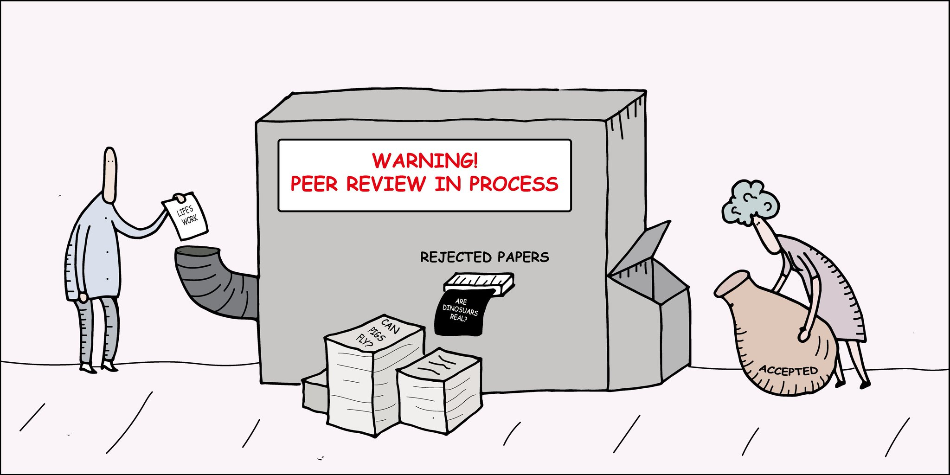
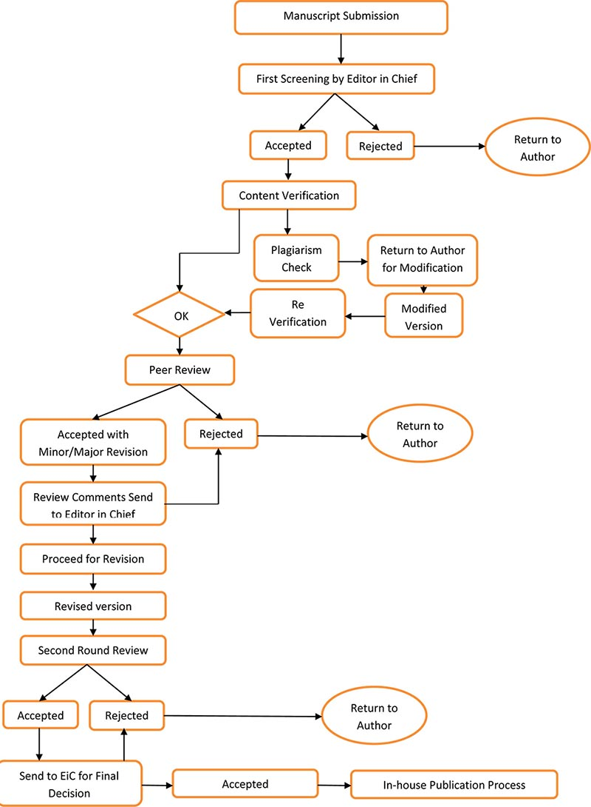

Slide 23
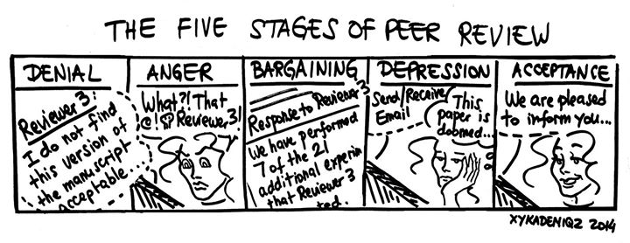
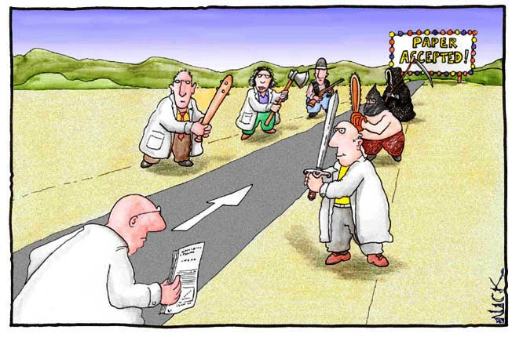
Handle reviews

Slide 24
Publishing (open access)

